Slide 1
Human Gender Identification Using Metabolomics Data
BIL 496
Preliminary Presentation
Zafer Altay
Project Mentor: Doç. Dr. Habil KALKAN
March 2022

Slide 2
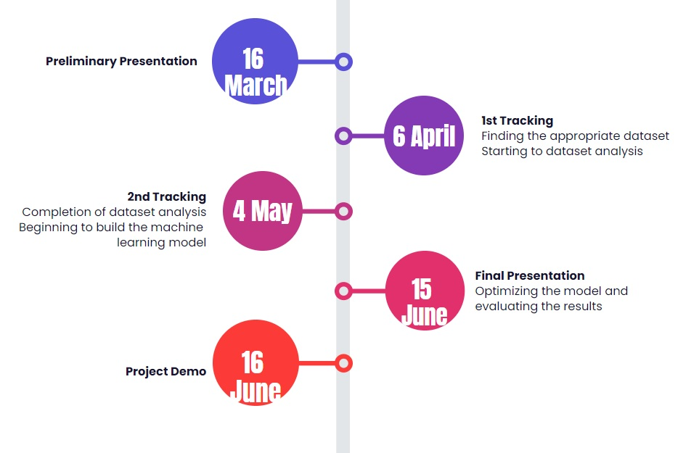
Timeline

Slide 3
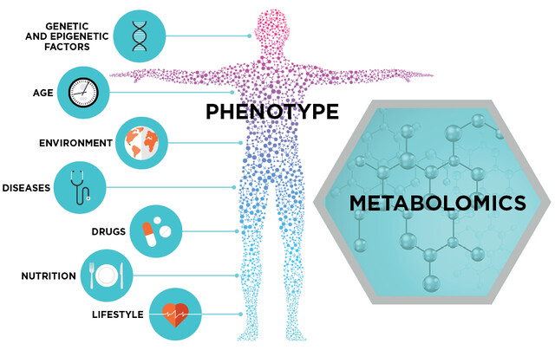
Project Scheme and Description
Metabolomics Data Analysis
Metabolomic
Metabolite
Machine Learning
Gender Identification
Disase Relation

Slide 4
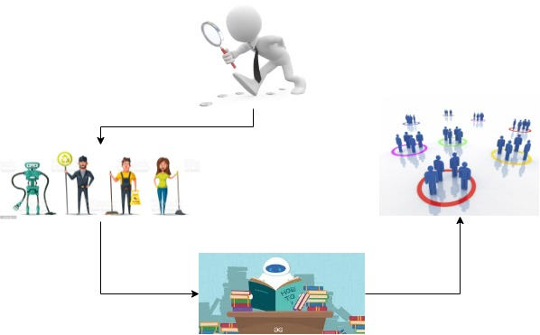
Project Design Plan
Find Dataset
Data PreProcessing and Data Cleaning
Build Model and Try ML Algorithm
Get Result

Slide 5
Project Requirements
Python
Numpy
Pandas
Keras
Tensorflow
Metabolomics Datasets

Slide 6
Success Criterias
For gender identification at least 70% success rate(Male-Female)
70% success rate in classifying data classified by gender according to age(20-30/40-50 etc.)

Slide 7
Resources
https://stringfixer.com/tr/Metabolomics
https://www.metaboanalyst.ca/docs/Format.xhtml
https://www.metabolomicsworkbench.org/
https://hmdb.ca/
https://pubmed.ncbi.nlm.nih.gov/?term=%22Metabolomics%2Fmethods%22%5BMAJR%5D&page=2

